Slide 1




By Ashish Sawant.
Financial Analysis Dashboard

Slide 2

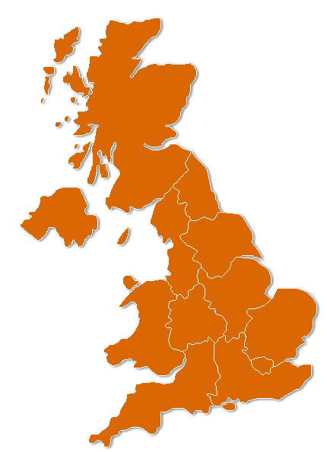
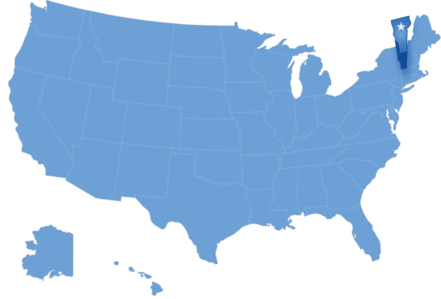

Introduction
📊 Welcome to our presentation on the Financial Analysis Dashboard!
🌏 Explore revenue data from three distinct regions: Asia, UK, and USA.
💼 Gain insights into revenue generated by different products and sales representatives.
📈 Analyze growth rates to understand the company's performance dynamics.
💡 Uncover strategic opportunities for driving sustainable growth.
🔍 Join me as I navigate through the dashboard to unlock actionable insights!

Slide 3
ASIA REGION

Slide 4
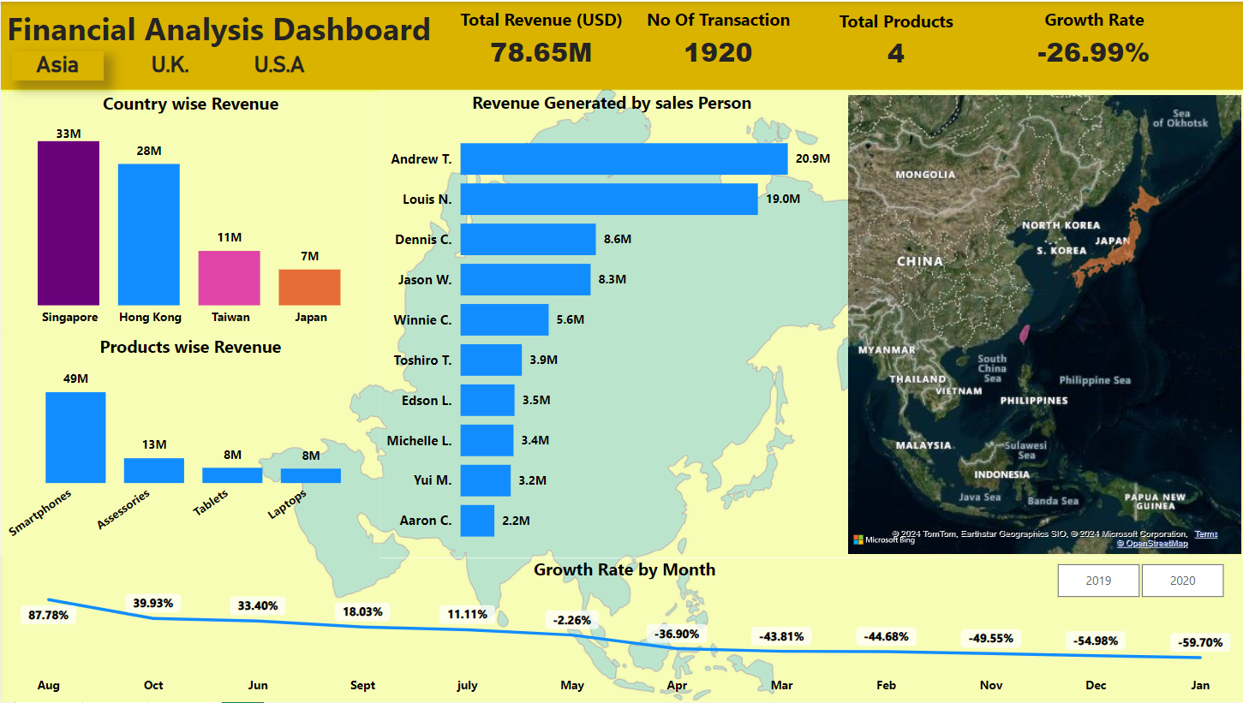

Slide 5
Key Insights
Singapore leads in revenue generation with 💰 $33 million USD, driven mainly by smartphone sales, which contribute 50% of the total revenue.
Hong Kong, Taiwan, and Japan are also significant contributors to the region's total revenue.
The company experienced a decreasing growth rate due to the COVID-19 pandemic impacting sales from 2019 to 2020.
Total revenue for the Asia region amounts to 💵 $78.65 million USD.
Smartphone sales play a critical role in revenue generation across all countries in the region.

Slide 6
U.K. REGION

Slide 7
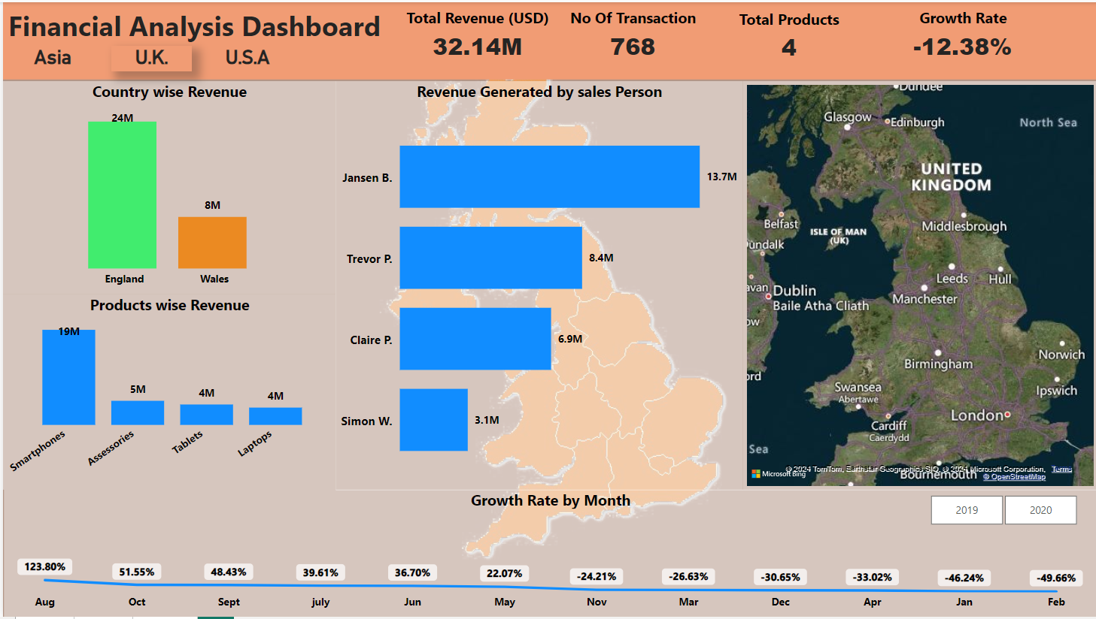

Slide 8
Key Insights
England generates the highest revenue at 💷 USD 24 million, with smartphone sales contributing 68% of the total revenue.
Wales also contributes to the region's revenue, although to a lesser extent.
The growth rate remained stable from August 2018 to May 2019 but declined afterward due to the COVID-19 pandemic.
Total revenue for the UK region stands at 💷 $32.14 million USD.
The company's reliance on smartphone sales underscores the importance of adapting to changing market conditions.

Slide 9
U.S.A. REGION

Slide 10
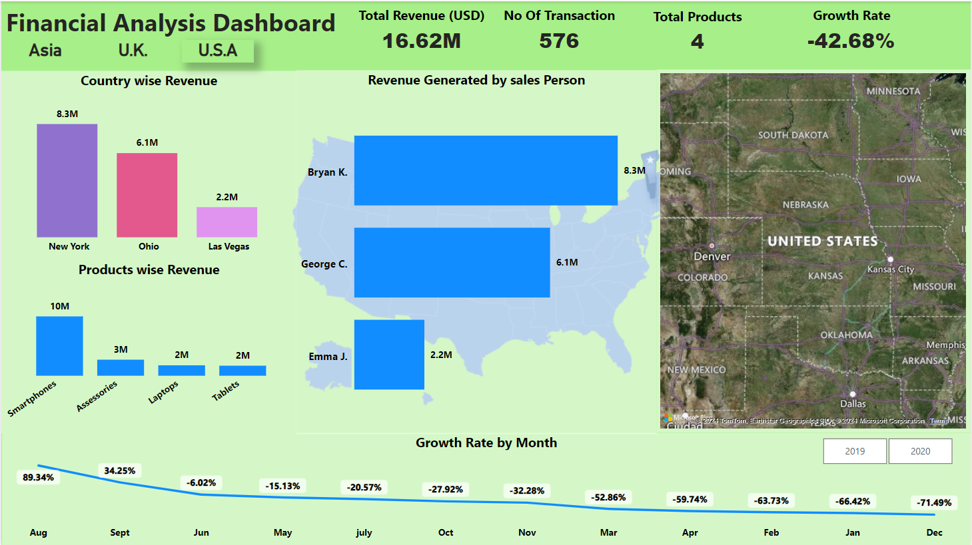

Slide 11
Key Insights
New York leads in revenue generation with 💵 $8.3 million USD, with smartphone sales accounting for a significant portion, generating 💰 $10 million USD in revenue.
Ohio and Las Vegas also contribute to the region's revenue, albeit to a lesser extent.
Total revenue for the USA region is 💵 $16.62 million USD.
Similar to other regions, the company faced challenges in growth due to the impact of the COVID-19 pandemic.
Smartphone sales emerge as the primary revenue driver, emphasizing the need for strategic adaptation in response to market disruptions

Slide 12

Hii 🖐
Greetings! 👋 I'm Ashish Sawant, a data analyst with a finance specialisation and an engineering degree. 💼 I've crafted this advanced dashboard using Power BI to offer a detailed glimpse into our financial landscape. 📊 Join me as we dive into the intricacies of our data analysis journey! 🚀

Slide 13
Financial Analysis Dashboard
Thank you very much!

